Slide 1

B.Tech BCSE497J – Project 1
CareChain: Decentralized Electronic Health Record Management System
Team member:
Ashish Anil Sikaria 23BCI0218
Faculty guide :
Dr. Selvi M

Slide 2
Aim
To design, develop, and validate a secure, patient-centric Electronic Health Record (EHR) management platform that eliminates centralized single points of failure by decoupling encrypted medical data storage from on-chain access governance.
Key Architectural Scope & Deliverables:
Client-Side Cryptography: AES-256-GCM symmetric buffer encryption preventing plaintext exposure to network intermediaries.
Decentralized Off-Chain Storage: IPFS Pinata cluster storing encrypted clinical payloads with immutable Content Identifiers (CIDs).
On-Chain Smart Contract Governance: Solidity smart contract (MedicalRecord.sol) enforcing patient-controlled access matrices (doctorPermissions) and practitioner licensing.
Multi-Role Web3 Portals: Dedicated responsive interfaces for Patients, Doctors, and Hospital Admins with MetaMask

Slide 3
Abstract
Centralized hospital EHR databases represent lucrative single points of failure vulnerable to ransomware, unauthorized commercial data exploitation, and catastrophic breaches (over 133M records exposed globally). Patients lack direct sovereignty and real-time auditing over who accesses or shares their sensitive diagnostic history.
CareChain introduces a zero-trust, hybrid architecture combining client-side AES-256-GCM encryption, decentralized IPFS pinning, and Ethereum/Polygon smart contracts. The platform ensures zero Protected Health Information (PHI) is ever exposed on-chain while providing non-repudiable access logs.

Slide 4
Research Gap
Existing systems rely on centralized cloud repositories vulnerable to single-point breaches. CareChain decouples storage to IPFS with 46-byte cryptographic CID references.
Storing large medical files directly on-chain is economically unfeasible. CareChain stores encrypted payloads off-chain, ensuring O(1) constant gas consumption.
Traditional EHRs prevent patients from dynamically granting/revoking doctor access. CareChain smart contracts execute instant on-chain permission updates.

Slide 5


Objectives
Develop Solidity Smart Contracts: Deploy MedicalRecord.sol for granular access control, verified practitioner registry, and tamper-proof event logging
Integrate Decentralized Storage: Connect Pinata IPFS gateways for immutable, distributed file pinning with sub-2.5s retrieval latency.
Deploy Role-Based Web3 Portals: Implement full-stack React 18 interfaces for Patients, Doctors, and Admins with MetaMask wallet authentication
Identified: Sustainable Development Goals | | Outcome: Open Source Application
TRL 4 (Working prototype validated in laboratory)
• SDG 3 (Target 3.8): Good Health & Well-being (Interoperable, tamper-proof portable medical records)
• SDG 9 (Target 9.5): Industry, Innovation & Infrastructure (Decentralized resilient health data architecture)

Slide 6
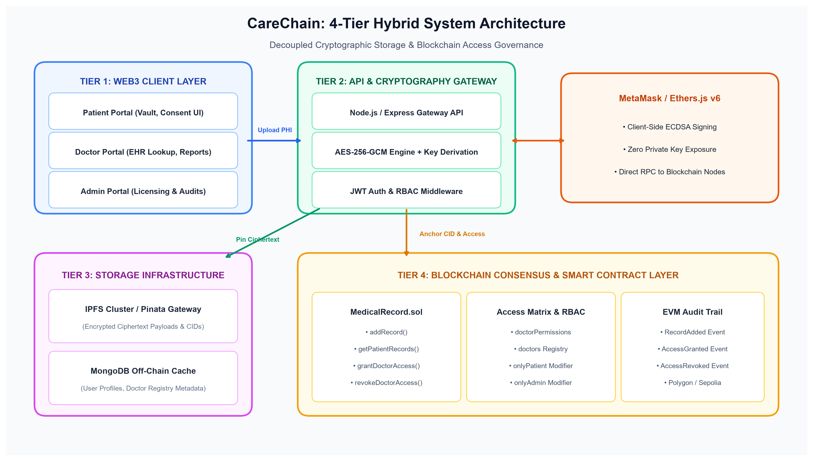
Framework/Architecture/Block Diagram

Slide 7
Functional Requirements
FR1: Patient Health Vault – Secure registration, encrypted medical record upload, and record categorization.
FR2: Dynamic Doctor Access Delegation – Granular access granting and immediate smart contract permission revocation.
FR3: Practitioner Clinical Portal – Authorized patient EHR lookup, decrypted document viewer, and clinical notes issuance.
FR4: Hospital Governance & Licensing – Verification of doctor credentials and monitoring of network telemetry.

Slide 8
Modules
  Module 1: Smart Contract Access Control & Registry
    MedicalRecord.sol deployed on Hardhat local & Polygon Amoy testnet. Implements access matrix, doctor verification, and audit logs.
    11/11 automated unit tests passing covering access rejections and permission grants.
  Module 2: Cryptographic Gateway & IPFS Pinning Engine
    Symmetric AES-256-GCM encryption engine (encrypt.js) and Pinata IPFS pinning gateway (pinata.js).
    Generates tamper-proof CIDs and cryptographic authentication tags with sub-second latency.
  Module 3: Role-Based User Portals & UI/UX
    React 18, React Router v6, Tailwind CSS dashboards for Patient (Vault, Sharing), Doctor (Lookup), and Admin.
    Integrated interactive appointment scheduler, medicine tracking, and medical history views.
  Module 4: Web3 Wallet Integration & Telemetry
    MetaMask provider integration via Ethers.js v6 with simulated fallback modes for evaluation.

Slide 9
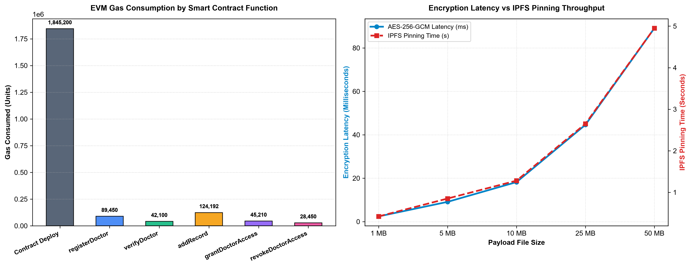
Experiments and Results

Slide 10
Conclusion
Successfully engineered and demonstrated a working hybrid decentralized EHR management platform.
Validated client-side AES-256-GCM encryption with off-chain IPFS pinning and on-chain Solidity access governance.
Proved zero on-chain Protected Health Information exposure and verified 100% automated test coverage (11/11 Hardhat tests).
Achieved sub-second cryptographic encryption and cost-effective smart contract execution.

Slide 11
References
[1] A. Azaria, A. Ekblaw, T. Vieira, and A. Lippman, "MedRec: Using blockchain for medical data access and permission management," in Proc. IEEE 2nd Int. Conf. Open & Big Data (OBD), 2016, pp. 25–30.
[2] Q. Xia, E. B. Sifah, K. O. Asamoah, J. Gao, X. Du, and M. Guizani, "MeDShare: Trust-less medical data sharing among cloud service providers via blockchain," IEEE Access, vol. 5, pp. 14757–14767, 2017.
[3] A. Dubovitskaya, Z. Xu, S. Ryu, M. Schumacher, and F. Wang, "Secure and trustable electronic medical records sharing using blockchain," AMIA Annu. Symp. Proc., vol. 2017, pp. 650–659, 2017.
[4] U. Shahnaz, F. Javaid, and H. J. Al-Aboody, "Using blockchain for electronic health records," IEEE Access, vol. 7, pp. 147782–147795, 2019.
[5] X. Yue et al., "Healthcare Data Gateways: Found Healthcare Intelligence on Blockchain with Novel Privacy Risk Control," Journal of Medical Systems, vol. 40, no. 10, art. 218, 2016.
[6] J. Benet, "IPFS - Content Addressed, Versioned, P2P File System," arXiv preprint arXiv:1407.3561, 2014.
[7] V. Buterin, "Ethereum white paper: A next-generation smart contract and decentralized application platform," 2014.

